Slide 1
ASTLI
Advanced
Smart
Traffic Lights Concept
Andrea Leganza
Ghenadie Artic
Alberto Coluzzi

Slide 2

ASTLI
Current Traffic Lights could be improved in some aspects...

Slide 3

ASTLI
Traffic Pollution: stopping cars at traffics lights with fixed time increases pollution.

Slide 4

ASTLI
Traffic congestion : fixed red time doesn't help when most of the traffic is along a single path at a precise time of the day (e.g. 8-9 am, 17-19 pm).

Slide 5


ASTLI
Safety: during night hours flashing yellow lights will induce some drivers to speed up ignoring safety.

Slide 6
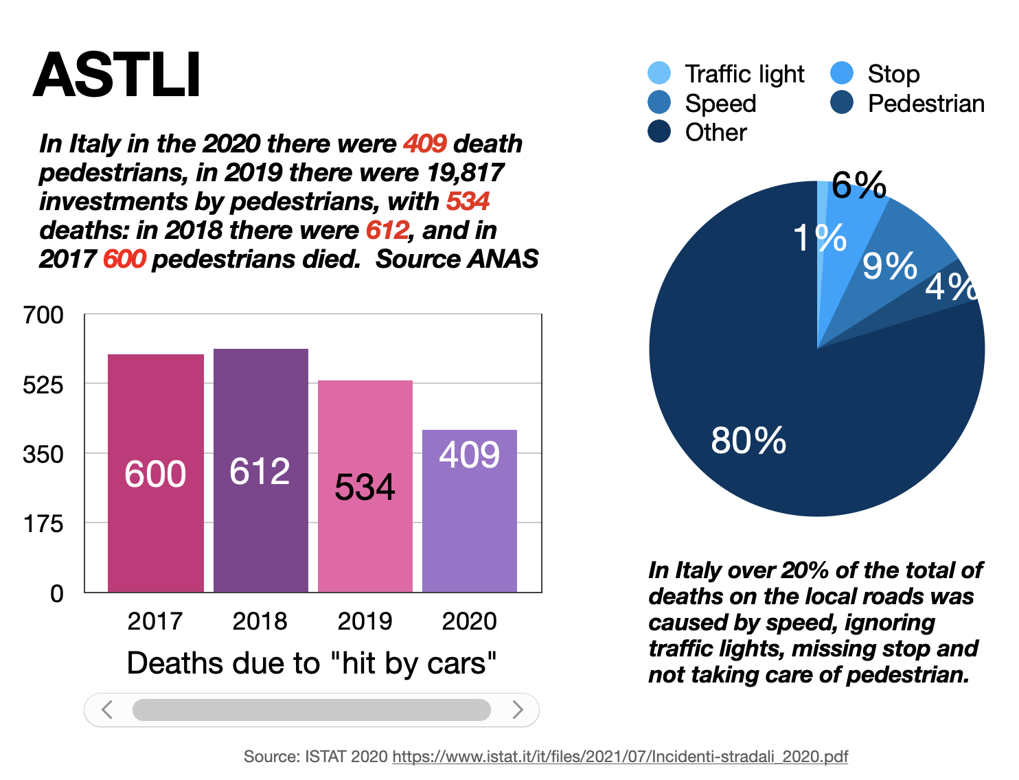

Slide 7

ASTLI
Energy: keeping traffic lights fully on when no cars are in the line is a waste of energy, even by day.

Slide 8

How ASTLI could solve these problems?

Slide 9


ASTLI
"Red light" pollution: reducing traffic lights red time analyzing current queue length and neighbors traffic lights, also by activating right/left turn depending on detected traffic.
Optimized: give more time to busiest lines
Control turn lights depending on traffic

Slide 10


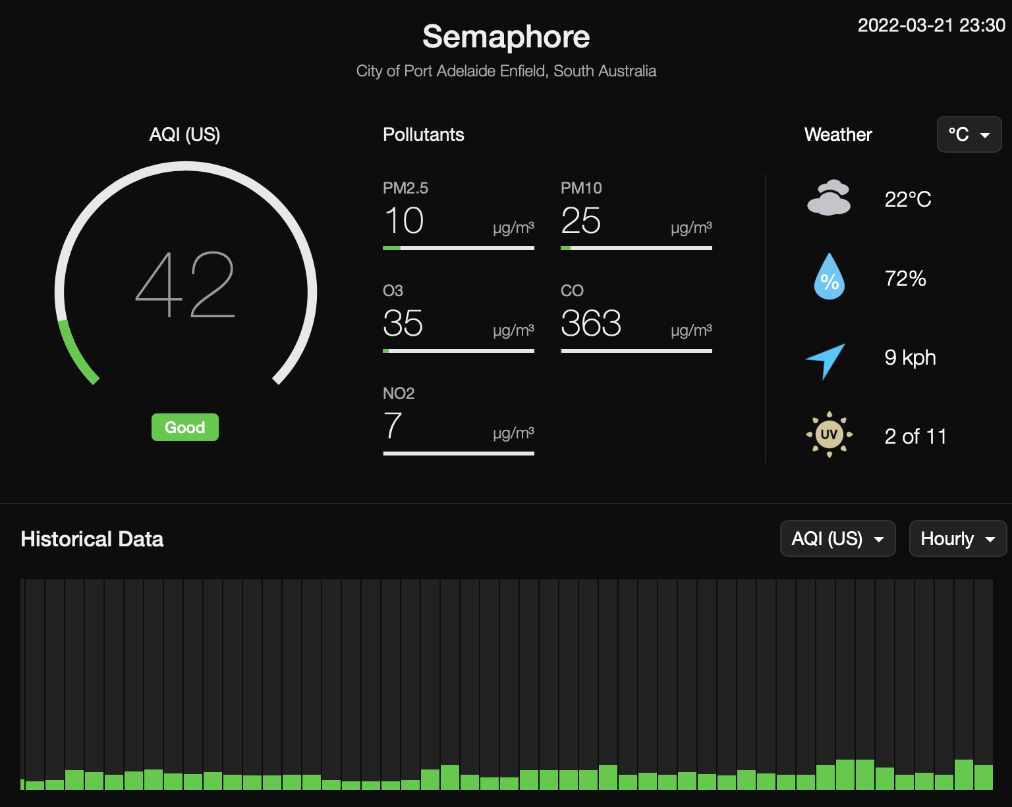
ASTLI
Air pollution: becoming pollutions stations, recording data which lets municipal administrations plan viability improvements.

Slide 11


ASTLI
Pedestrians security: enabling traffic lights during night when a pedestrian is detected (instead of yellow blinking).

Slide 12


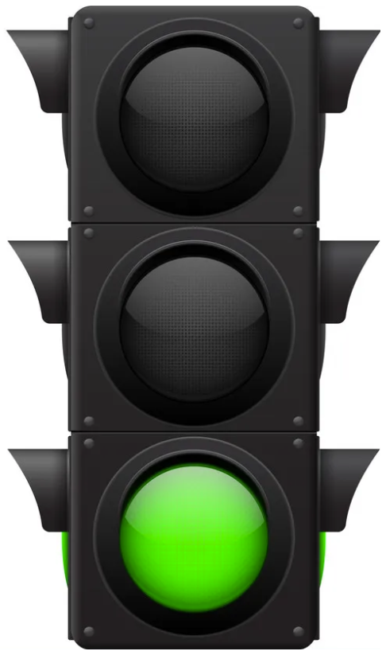
ASTLI
Drivers/pedestrian security: enabling traffic lights facing red during night when driver excessive speed is detected.

Slide 13



ASTLI
Drivers/pedestrian security: enabling traffic lights facing red during night when driver excessive speed is detected.

Slide 14

ASTLI
Energy: reducing lights signals frequency time during day and night when no cars/pedestrians are detected.

Slide 15
ASTLI
Advanced
Smart
Traffic Lights Technology
Andrea Leganza
Ghenadie Artic
Alberto Coluzzi

Slide 16
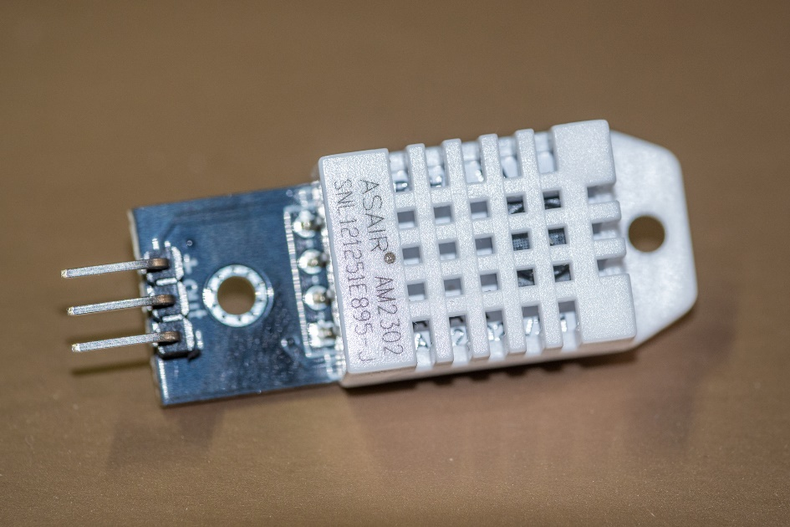
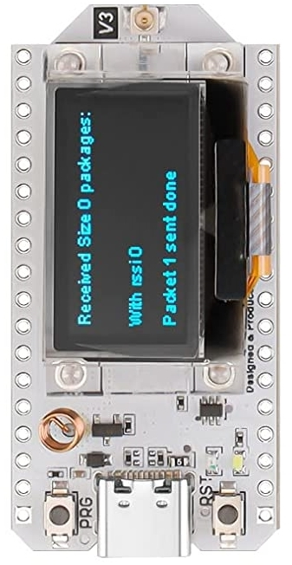
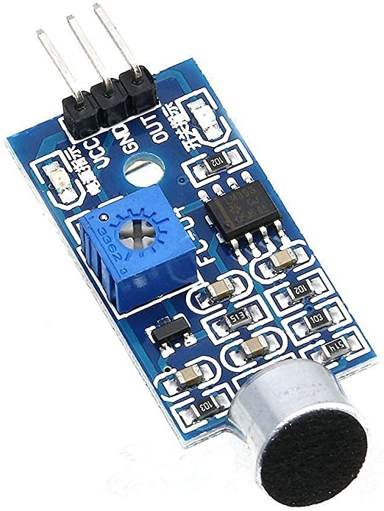
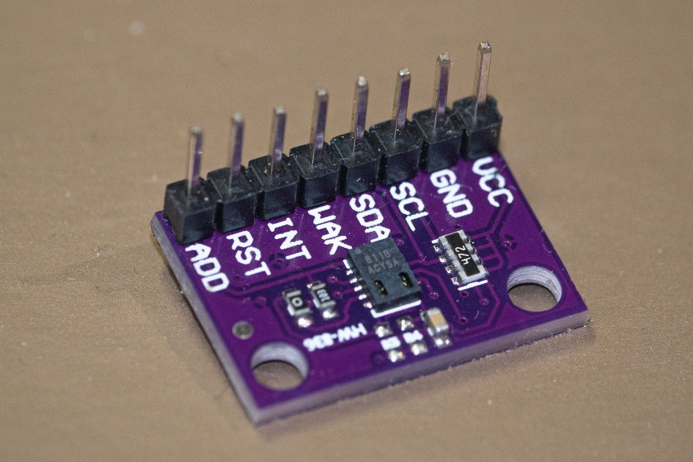
ASTLI
Central ESP-32
Humidity and temperature
Sound
Pollution
Sensor: monitoring of pollution
Sensor: monitoring of noise
Sensor: monitoring of temperature & humidity

Slide 17
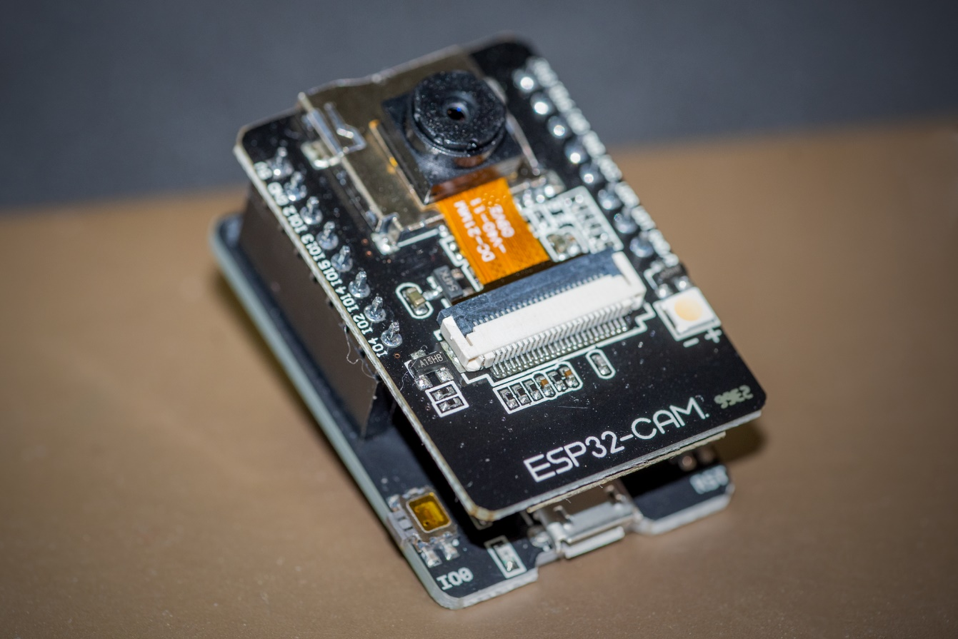
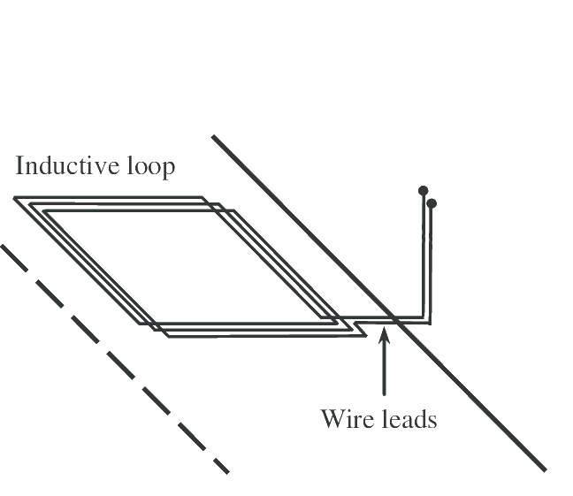
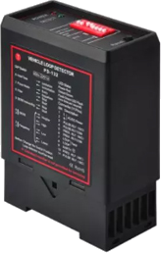
ASTLI
ESP-32
Traffic jams: ESP-32 camera (data capture)

Slide 18



ASTLI
ESP-32
Remote Gateway ESP-32
Central ESP-32

Slide 19

ASTLI
INTERNET
Web Dashboard
Remote Gateway ESP-32
Central ESP-32

Slide 20
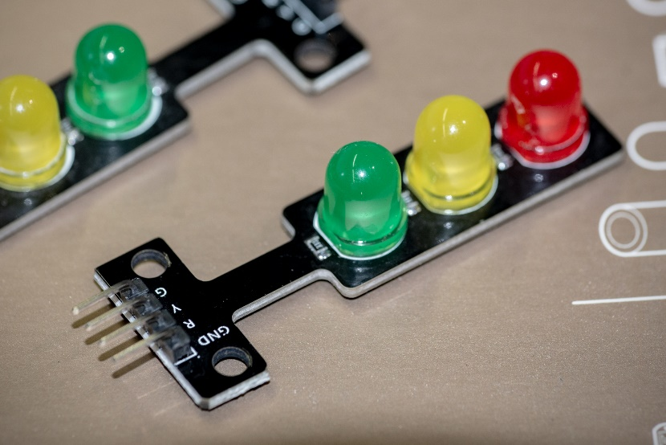
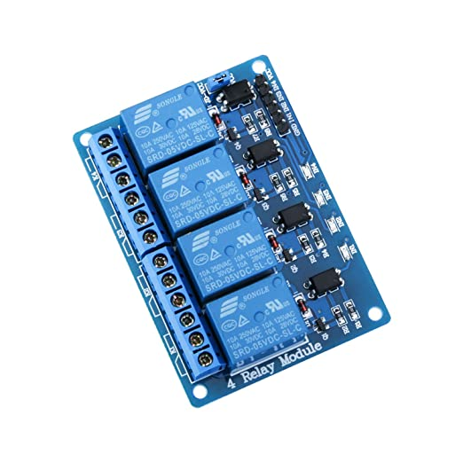

ASTLI
Prototype
Commercial version
Central ESP-32
Relay

Slide 21
ASTLI
Advanced
Smart
Traffic Lights Evaluation
Andrea Leganza
Ghenadie Artic
Alberto Coluzzi

Slide 22
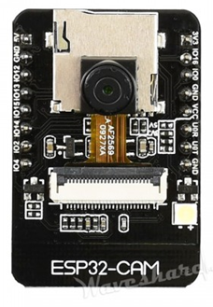
ASTLI
POWER
We expect to draw current from the grid to power our project, so it would be more stable, since we don’t want to have malfunction on the microcontroller and on the Wi-Fi connection
CONNECTIVITY
The ESP32-CAM will be connected to the main ESP32 with a stream on wifi
COST
This module cost 12€, and it’s a very cheap way to obtain a video stream, we also would like to reduce as much the number of camera to reduce cost and reduce current needs
ESP32-CAM

Slide 23
ASTLI
POWER
The esp32 would also be connected to the grid and would be placed in the electrical box so it could power directly the road junction
CONNECTIVITY
We choose to use lora to connect back to the main hub, and use wifi to connect with other esp32
COST
The choice of only one esp32 with lora for junction is to reduce cost
ESP32-LORA

Slide 24
ASTLI
LATENCY DETECTION
The response time in which the system understand the passage of a car is important to build a reliable system
DETECTION ACCURACY
How much the system can detect accurately, with influence from external factors (such as bright and low light condition)
OTHER MEASURING
We can evaluate our product also on number of accident on the junction, pollutants in the air and time spent in the junction
END-USER
EXPERIENCE

Slide 25
ASTLI
Thank you

